Slide 1
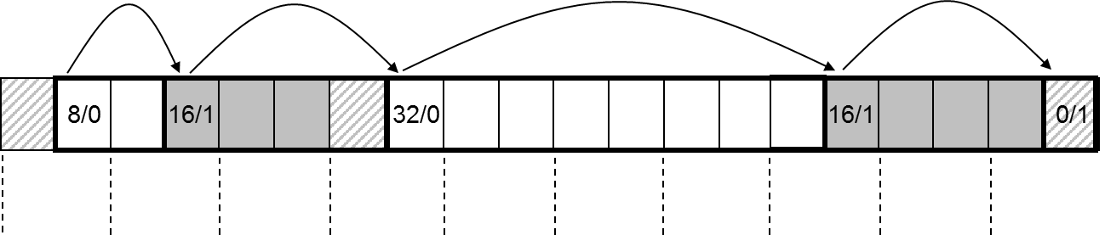
Memory Abstraction Dynamic Memory Allocation I

Slide 2
Announcement
Mid-term exam
Time:7:00-9:00pm on 04/23 (Wed)
Place: here
Range: everything up to RE (Runtime Environment/Libraries)
Closed-book exam

Slide 3
Dynamic Memory Allocation
Part I: Basic Concepts & K&R Implementation Overview
Part II: Detailed K&R Implementation & Optimizations
(Some of the slides are borrowed from Princeton University COS217)

Slide 4
Overview
Part I: Basic Concept & K&R Implementation Overview
Dynamic Memory Allocation in C
The Heap
Fragmentation
K&R Implementation Overview
Summary

Slide 5
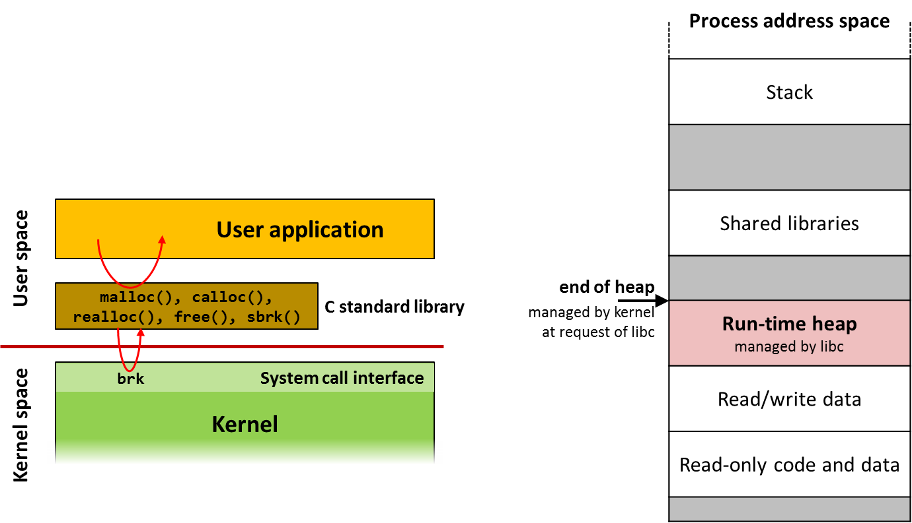
Dynamic Memory Allocation in C

Slide 6
Dynamic Memory Allocation?
Why not use global variables?
The size of certain data structures may be known only at runtime
Dynamically allocate and free memory as needed
explicit
languages closer to hardware
implicit
higher-level languages, functional languages, scripting languages
C++: vector, map, …
JavaScript/Python: dictionaries, strings, …

Slide 7
Dynamic Memory Allocation in C
C standard library functions related to dynamic memory allocation
Operation | API | Variants
Allocate memory | void* malloc(size_t size) | calloc (zero-initialize the memory)
Reallocate memory | void* realloc(void *ptr, size_t size)
Free memory | void free(void *ptr)
Allocate automatically freed memory (allocated at stack not heap) | void* alloca(size_t size)
Find end of heap | void* sbrk(0)

Slide 8
The realloc Function
void *realloc(void *ptr, size_t size);
Resize a dynamically allocated array
ptr must point to a memory block obtained by a previous call of malloc, calloc, or realloc. size represents the new size of the block, which may be larger or smaller than the original size
Return value
When it succeeds, it returns a pointer to the newly allocated memory, which may or may not be different from ptr.
When realloc fails, it returns NULL, and the old block is unchanged.
Properties of realloc:
When memory expanding, realloc doesn’t initialize the newly-added bytes
If ptr == NULL, it behaves like malloc
If size == 0, it frees the memory block

Slide 9
The realloc Function
We expect realloc to be reasonably efficient:
When reducing the size, realloc should shrink the block “in place”
realloc always attempts to expand a block without moving it
realloc could move the memory block
If it can’t enlarge ptr in place, it allocates a new block elsewhere, then copy the contents of the old block into it
In that case, the return pointer != ptr
Make sure to update all pointers to the memory block in case it has been moved by realloc

Slide 10
Example of Dynamic Memory Allocation in C
void foo(int n, int m) {
int i, *p;
// Allocate a block memory to hold n integers
p = (int *) malloc(n * sizeof(int));
if (p == NULL) { perror("malloc"); exit(EXIT_FAILURE); } // initialize array for (i=0; i<n; i++) p[i] = i; // resize array to hold n+m integers
p = (int *) realloc(p, (n+m) * sizeof(int));
if (p == NULL) { perror(“realloc"); exit(EXIT_FAILURE); } // initialize rest of array
for (i=n; i<n+m; i++) p[i] = i;
// print arrays
for (i=0; i<n+m; i++) printf(“%d\n”, [i]);
// announce that we do not use the memory anymore
free(p);
p = NULL;
}

Slide 11
Example of Dynamic Memory Allocation in C
?
void foo(int n=256, int m=256) {
int i, *p;
// Allocate a block memory to hold n integers
p = (int *) malloc(n * sizeof(int) = 1024);
if (p == NULL) { … } // initialize array for (i=0; i<n; i++) p[i] = i; // resize array to hold n+m integers
p = (int *)realloc(p, (n+m)*sizeof(int) = 2048);
if (p == NULL) { … } // initialize rest of array
for (i=n; i<n+m; i++) p[i] = i;
// print arrays
for (i=0; i<n+m; i++) printf(“%d\n”, [i]);
// announce that we do not use the memory …
free(p);
p = NULL;
}
p
p
p
p
p
p
 | 6003fc
 | 600400
 | 600404
 | 6007fc
 | 600800
 | 600804
 | 600bfc
 | 600c00
 | 600c04
p
p
p

Slide 12
Example of Dynamic Memory Allocation in C
void foo(int n=256, int m=256) {
int i, *p;
// Allocate a block memory to hold n integers
p = (int *) malloc(n * sizeof(int) = 1024);
if (p == NULL) { … } // initialize array for (i=0; i<n; i++) p[i] = i; // resize array to hold n+m integers
p = (int *)realloc(p, (n+m)*sizeof(int) = 2048);
if (p == NULL) { … } // initialize rest of array
for (i=n; i<n+m; i++) p[i] = i;
// print arrays
for (i=0; i<n+m; i++) printf(“%d\n”, [i]);
// announce that we do not use the memory …
free(p);
p = NULL;
}
p
p
p
p
p
p
 | 6003fc
 | 600400
 | 600404
 | 6007fc
 | 600800
 | 600804
 | 600bfc
 | 600c00
 | 600c04
p
p
p

Slide 13
Example of Dynamic Memory Allocation in C
void foo(int n=256, int m=256) {
int i, *p;
// Allocate a block memory to hold n integers
p = (int *) malloc(n * sizeof(int) = 1024);
if (p == NULL) { … } // initialize array for (i=0; i<n; i++) p[i] = i; // resize array to hold n+m integers
p = (int *)realloc(p, (n+m)*sizeof(int) = 2048);
if (p == NULL) { … } // initialize rest of array
for (i=n; i<n+m; i++) p[i] = i;
// print arrays
for (i=0; i<n+m; i++) printf(“%d\n”, [i]);
// announce that we do not use the memory …
free(p);
p = NULL;
}
p
p
p
p
p
p
 | 6003fc
 | 600400
 | 600404
 | 6007fc
 | 600800
 | 600804
 | 600bfc
 | 600c00
 | 600c04
p
p
p

Slide 14
Example of Dynamic Memory Allocation in C
void foo(int n=256, int m=256) {
int i, *p;
// Allocate a block memory to hold n integers
p = (int *) malloc(n * sizeof(int) = 1024);
if (p == NULL) { … } // initialize array for (i=0; i<n; i++) p[i] = i; // resize array to hold n+m integers
p = (int *)realloc(p, (n+m)*sizeof(int) = 2048);
if (p == NULL) { … } // initialize rest of array
for (i=n; i<n+m; i++) p[i] = i;
// print arrays
for (i=0; i<n+m; i++) printf(“%d\n”, [i]);
// announce that we do not use the memory …
free(p);
p = NULL;
}
p
p
p
p
p
p
 | 6003fc
 | 600400
 | 600404
 | 6007fc
 | 600800
 | 600804
 | 600bfc
 | 600c00
 | 600c04
p
p
p

Slide 15
Example of Dynamic Memory Allocation in C
void foo(int n=256, int m=256) {
int i, *p;
// Allocate a block memory to hold n integers
p = (int *) malloc(n * sizeof(int) = 1024);
if (p == NULL) { … } // initialize array for (i=0; i<n; i++) p[i] = i; // resize array to hold n+m integers
p = (int *)realloc(p, (n+m)*sizeof(int) = 2048);
if (p == NULL) { … } // initialize rest of array
for (i=n; i<n+m; i++) p[i] = i;
// print arrays
for (i=0; i<n+m; i++) printf(“%d\n”, [i]);
// announce that we do not use the memory …
free(p);
p = NULL;
}
p
p
p
p
p
p
 | 6003fc
 | 600400
 | 600404
 | 6007fc
 | 600800
 | 600804
 | 600bfc
 | 600c00
 | 600c04
p
p
p
0 (NULL)

Slide 16
malloc() and free() Challenges
malloc() may ask for arbitrary number of bytes
Memory may be allocated & freed in different order
Cannot reorder requests to improve performance
char *p1 = malloc(3);
char *p2 = malloc(1);
char *p3 = malloc(4);
free(p2);
char *p4 = malloc(6);
free(p3);
char *p5 = malloc(2);
free(p1);
free(p4);
free(p5);

Slide 17
Heap: Dynamic Memory
#include <stdlib.h> void *malloc(size_t size); void free(void *ptr);
0
Heap
p1
char *p1 = malloc(3);
char *p2 = malloc(1);
char *p3 = malloc(4);
free(p2);
char *p4 = malloc(6);
free(p3);
char *p5 = malloc(2);
free(p1);
free(p4);
free(p5);
}
Heap
Stack
0xffffffff

Slide 18
Heap: Dynamic Memory
#include <stdlib.h> void *malloc(size_t size); void free(void *ptr);
0
Heap
p1
char *p1 = malloc(3);
char *p2 = malloc(1);
char *p3 = malloc(4);
free(p2);
char *p4 = malloc(6);
free(p3);
char *p5 = malloc(2);
free(p1);
free(p4);
free(p5);
p2
}
Heap
Stack
0xffffffff

Slide 19
Heap: Dynamic Memory
#include <stdlib.h> void *malloc(size_t size); void free(void *ptr);
0
Heap
p1
char *p1 = malloc(3);
char *p2 = malloc(1);
char *p3 = malloc(4);
free(p2);
char *p4 = malloc(6);
free(p3);
char *p5 = malloc(2);
free(p1);
free(p4);
free(p5);
p2
}
p3
Heap
Stack
0xffffffff

Slide 20
Heap: Dynamic Memory
#include <stdlib.h> void *malloc(size_t size); void free(void *ptr);
0
Heap
p1
char *p1 = malloc(3);
char *p2 = malloc(1);
char *p3 = malloc(4);
free(p2);
char *p4 = malloc(6);
free(p3);
char *p5 = malloc(2);
free(p1);
free(p4);
free(p5);
p2
}
p3
Heap
Stack
0xffffffff

Slide 21
Heap: Dynamic Memory
#include <stdlib.h> void *malloc(size_t size); void free(void *ptr);
0
Heap
p1
char *p1 = malloc(3);
char *p2 = malloc(1);
char *p3 = malloc(4);
free(p2);
char *p4 = malloc(6);
free(p3);
char *p5 = malloc(2);
free(p1);
free(p4);
free(p5);
p2
}
p3
p4
Heap
Stack
0xffffffff

Slide 22
Heap: Dynamic Memory
#include <stdlib.h> void *malloc(size_t size); void free(void *ptr);
0
Heap
p1
char *p1 = malloc(3);
char *p2 = malloc(1);
char *p3 = malloc(4);
free(p2);
char *p4 = malloc(6);
free(p3);
char *p5 = malloc(2);
free(p1);
free(p4);
free(p5);
p2
}
p3
p4
Heap
Stack
0xffffffff

Slide 23
Heap: Dynamic Memory
#include <stdlib.h> void *malloc(size_t size); void free(void *ptr);
0
Heap
p1
char *p1 = malloc(3);
char *p2 = malloc(1);
char *p3 = malloc(4);
free(p2);
char *p4 = malloc(6);
free(p3);
char *p5 = malloc(2);
free(p1);
free(p4);
free(p5);
p5, p2
}
p3
p4
Heap
Stack
0xffffffff

Slide 24
Heap: Dynamic Memory
#include <stdlib.h> void *malloc(size_t size); void free(void *ptr);
0
Heap
p1
char *p1 = malloc(3);
char *p2 = malloc(1);
char *p3 = malloc(4);
free(p2);
char *p4 = malloc(6);
free(p3);
char *p5 = malloc(2);
free(p1);
free(p4);
free(p5);
p5, p2
}
p3
p4
Heap
Stack
0xffffffff

Slide 25
Heap: Dynamic Memory
#include <stdlib.h> void *malloc(size_t size); void free(void *ptr);
0
Heap
p1
char *p1 = malloc(3);
char *p2 = malloc(1);
char *p3 = malloc(4);
free(p2);
char *p4 = malloc(6);
free(p3);
char *p5 = malloc(2);
free(p1);
free(p4);
free(p5);
p5, p2
}
p3
p4
Heap
Stack
0xffffffff

Slide 26
Heap: Dynamic Memory
#include <stdlib.h> void *malloc(size_t size); void free(void *ptr);
0
Heap
p1
char *p1 = malloc(3);
char *p2 = malloc(1);
char *p3 = malloc(4);
free(p2);
char *p4 = malloc(6);
free(p3);
char *p5 = malloc(2);
free(p1);
free(p4);
free(p5);
p5, p2
}
p3
p4
Heap
Stack
0xffffffff

Slide 27

The Heap

Slide 28
Where Is Dynamic Memory Allocated?
Dynamic memory is allocated in an area called the heap
managed by the dynamic memory allocator implemented in the C standard library (libc)
libc uses system calls to the kernel to manage the upper end of the heap (brk(), sbrk())
Process address space
Stack
Shared libraries
Run-time heap managed by libc
Read/write data
Read-only code and data
User application
User space
end of heap
managed by kernel
at request of libc
malloc(), calloc(), realloc(), free(), sbrk()
C standard library
Kernel
System call interface
brk/mmap
Kernel space

Slide 29
Acquiring Heap Memory
Q: How does malloc() acquire heap memory?
A: Moves the program break downward via sbrk() or brk()system call
void *sbrk(intptr_t increment);
Increment the program break (i.e., end of heap) by the specified amount. Calling the function with an increment of 0 returns the current location of the program break. Return the ptr to the previous program break if successful and (void *)-1 otherwise.
int brk(void *newBreak);
Move the program break to the specified address. Return 0 if successful and -1 otherwise.

Slide 30
Using heap memory
Q: Having acquired heap memory, how do malloc() and free() manipulate it?
A: Topic of much research; an introduction…

Slide 31
Goals for malloc() and free()
Maximizing throughput
Maximize number of requests completed per unit time
Need both malloc() and free() to be fast
Maximizing memory utilization
Minimize the amount of wasted memory
Need to minimize size of data structures
Strawman #1: free() does nothing
Good throughput, but poor memory utilization
Strawman #2: malloc() finds the “best fit”
Good memory utilization, but poor throughput

Slide 32
Keeping track of free blocks
Maintain a list of free blocks of memory
Allocate memory from one of the blocks in the free list
Deallocate memory by returning the block to the free list
When necessary, call sbrk() to ask OS for additional memory, and create a new large block
Design questions
How to keep track of the free blocks in memory?
How to choose an appropriate free block to allocate?
What to do with the left-over space in a free block?
What to do with a block that has just been freed?
free
free
free

Slide 33
Need to minimize fragmentation
Internal fragmentation
Allocated block is larger than malloc() requested
E.g., malloc() imposes a minimum size (e.g., 64 bytes)
External fragmentation
Enough free memory exists, but no block is big enough
E.g., malloc() asks for 128 contiguous bytes
33
64
64
64
Notes:
Avoiding internal fragmentation: probably want a range of block sizes
Avoiding external fragmentation: need malloc() to be smart in selecting a good fit

Slide 34
Simple “K&R-Like” Approach
Memory allocated in multiples of a base size
E.g., 16 bytes, 32 bytes, 48 bytes, …
Linked list of free blocks
malloc() and free() walk through the list to allocate and deallocate
malloc() allocates the first big-enough block (first fit)
To avoid sequencing further through the list
malloc() splits the free block
To allocate what is needed, and leave the rest available
Linked list is circular
To be able to continue where you left off
Linked list in the order the blocks appear in memory
To be able to “coalesce” neighboring free blocks

Slide 35
Allocate Memory in Multiples of Base Size
Allocate memory in multiples of a base size
Avoid maintaining very tiny free blocks
Align memory on size of largest data type (e.g., double)
Requested size is “rounded up”
Allocation in units of base_size
Round:(nbytes+base_size–1)/base_size
Example:
Suppose nbytes is 37
And base_size is 16 bytes
Then (37 + 16 – 1)/16 is 52/16 which rounds down to 3
16
16
5
Notes:
Downside: some internal fragmentation…

Slide 36
Linked List of Free Blocks
Linked list of free blocks
malloc() allocates a big-enough block
free() adds newly-freed block to the list
Allocated
Newly
freed

Slide 37
“First-Fit” Allocation
Handling a request for memory (e.g., malloc())
Find a free block that satisfies the request
Must have a “size” that is big enough, or bigger
Simplest approach: first fit
Sequence through the linked list
Stop upon encountering a “big enough” free block
Example: request for 64 bytes
First-fit algorithm stops at the 128-byte block
48
32
128
64
256

Slide 38
Splitting an Oversized Free Block
Simple case: perfect fit
malloc() asks for 128 bytes, free block has 128 bytes
Simply remove the free block from the list
Complex case: splitting the block
malloc() asks for 64 bytes, free block has 128 bytes
48
32
128
64
256
48
32
64
64
256
64

Slide 39
Circular Linked List of Free Blocks
Advantages of making free list a circular list
Any element in the list can be the beginning
Don’t have to handle the “end” of the list as special
Performance optimization
Make the head be where last block was found
More likely to find “big enough” blocks later in the list
new head
48
32
64
64
256

Slide 40
Maintaining Free Blocks in Order
Keep list in order of increasing addresses
Makes it easier to coalesce adjacent free blocks
Though, makes calls to free() more expensive
Need to insert the newly-freed block in the right place
Free list
In
use
In
use
In
use

Slide 41
Summary
Summary
-------------
-------------
-------------
-------------
-------------
-----

Slide 42
Summary
Data that is allocated while the program is running is called dynamic memory.
Size does not have to be specified at compile time
Dynamically allocated memory blocks are allocated on the heap
Dynamically allocated memory that is no longer used must be freed manually in C
Dynamic memory allocator
Three core functions: malloc(), realloc(), and free()
Goals:
throughput (“be as fast as possible”)
peak utilization (“waste as little memory as possible”)
Goals are conflicting due to the nature of requests (cannot foresee, cannot buffer/delay)
Fragmentation
Internal: unused memory inside allocated blocks. Easy to quantify.
External: caused by non-consecutively located free blocks. Difficult to quantify.
K&R allocator overview

